Slide 1
Rainfall Prediction
Data Visualisation Project
on
By- Deepti Agarwal
Akrishna Agnihotri

Slide 2
Approach
01
02
03
04
Objectives
Data Preprocessing
Understanding the problem statement and the given dataset.
Cleaning the data by handling null values, outliers and categorical values.
Data Analysis
Time-Series Forecasting
Analysing various factors through graphs which affect the rainfall.
Identifying trends and seasonality to predict the rainfall.

Slide 3

Problem Statement
Predict tomorrow's rainfall using dataset available for area : Australia
Rainfall Prediction is one of the difficult and uncertain tasks that have a significant impact on human society. Timely and accurate forecasting can proactively help reduce human and financial loss.
Do a set of experiments that involve the use of common machine learning techniques to create models that can predict whether it will rain tomorrow or not based on the weather data for that day in major cities in Australia.

Slide 4
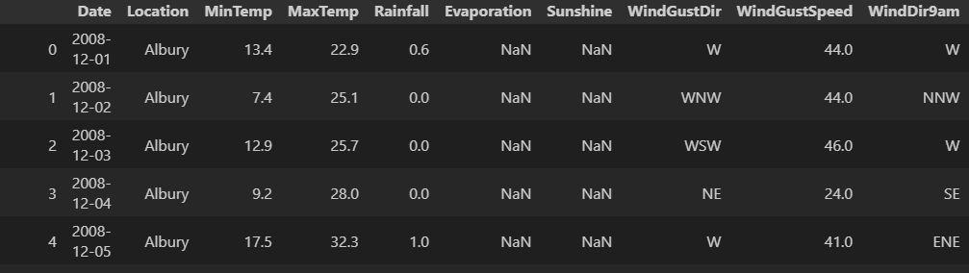
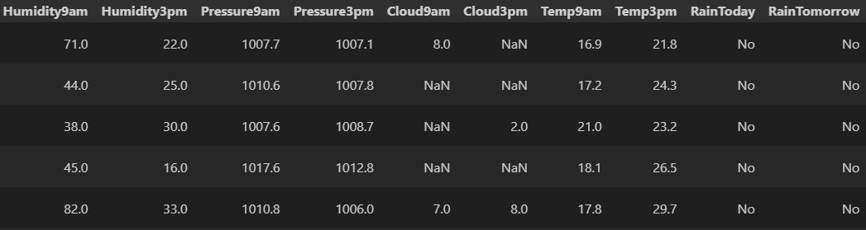
Dataset Information

Slide 5
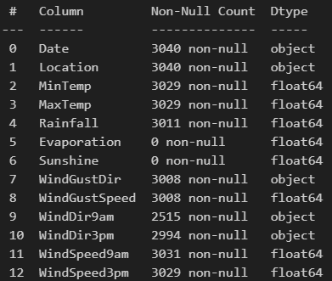
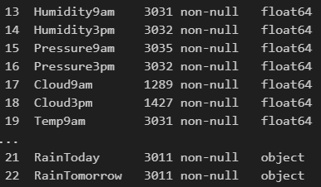
How many non-null values are there in the dataset and what are the datatypes of the columns?

Slide 6


How to handle null values?
Numerical columns = 16
Categorical Columns = 7
Null values from numerical columns are replaced with the median while the null values in categorical columns are replaced with the mode.

Slide 7
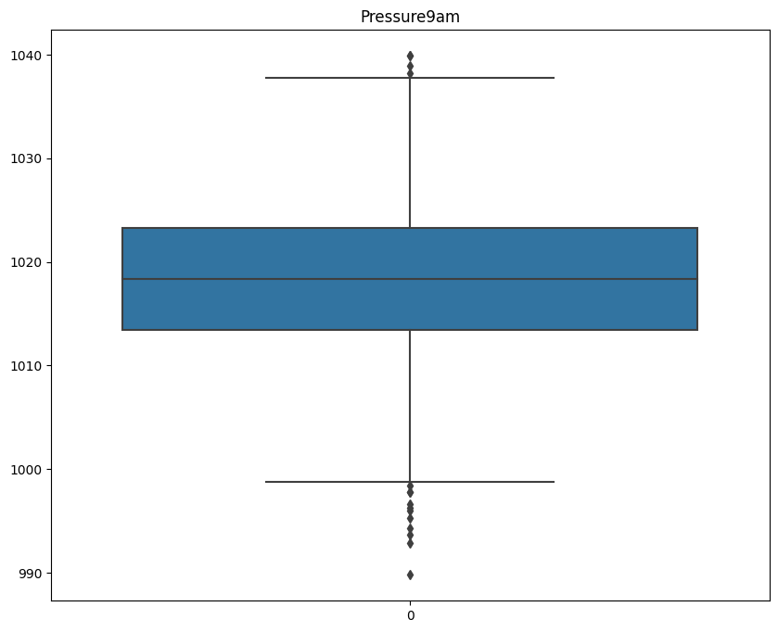
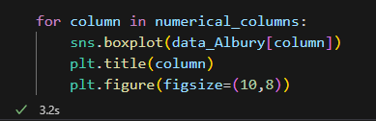
How to handle outliers?
Removing Outliers – Box plot is drawn to identify the columns with outliers.

Slide 8
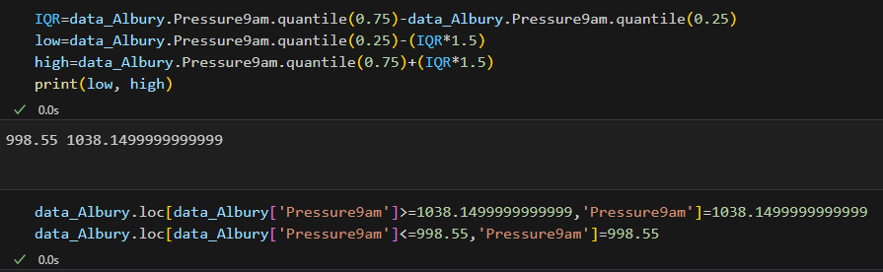
How to handle outliers?
Removing Outliers – Using the Inter-quartile range to remove the outliers.

Slide 9
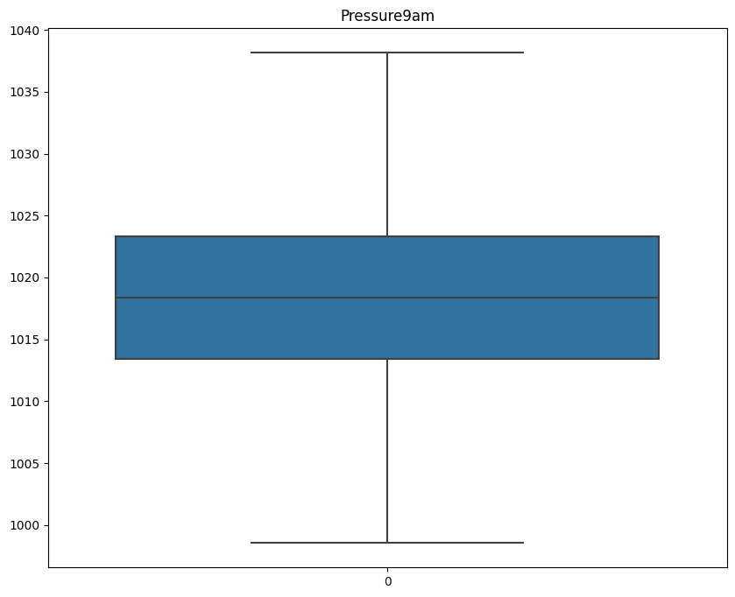
How to handle outliers?
Removing Outliers – Using the Inter-quartile range to remove the outliers.

Slide 10
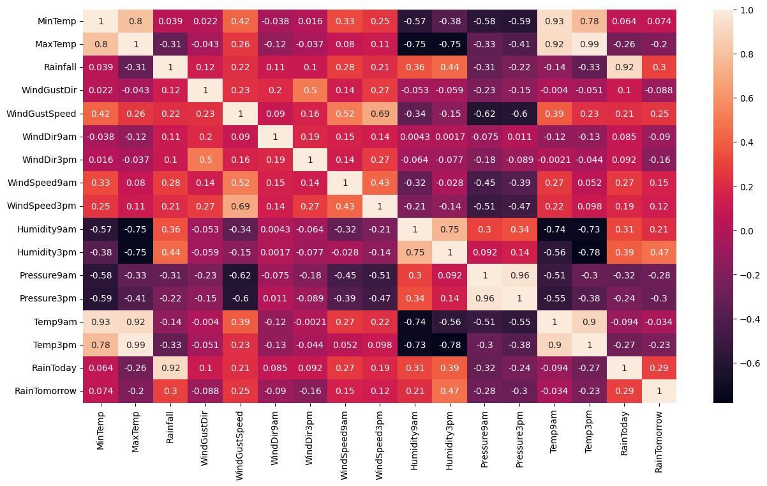
What is the correlation between various columns?
To find the
correlation
between
the various
columns, a
heatmap is
plotted.

Slide 11
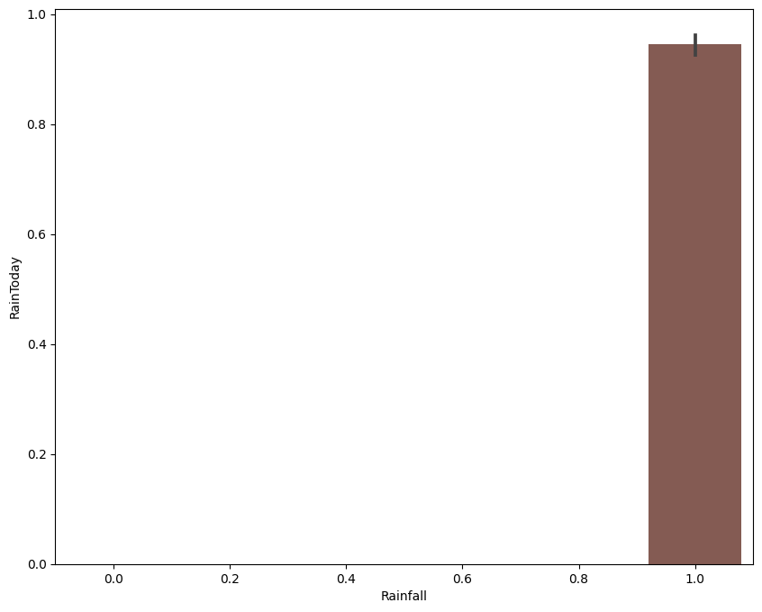
For what value of Rainfall, there are more chances of raining today?

Slide 12
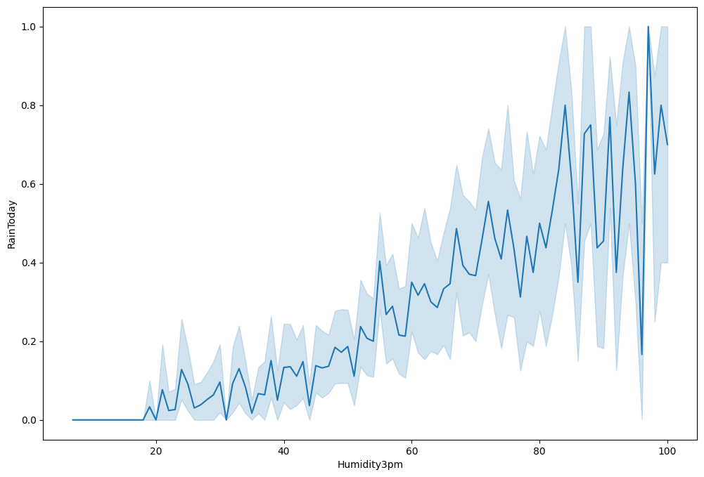
How Humidity affects chances of rainfall?

Slide 13
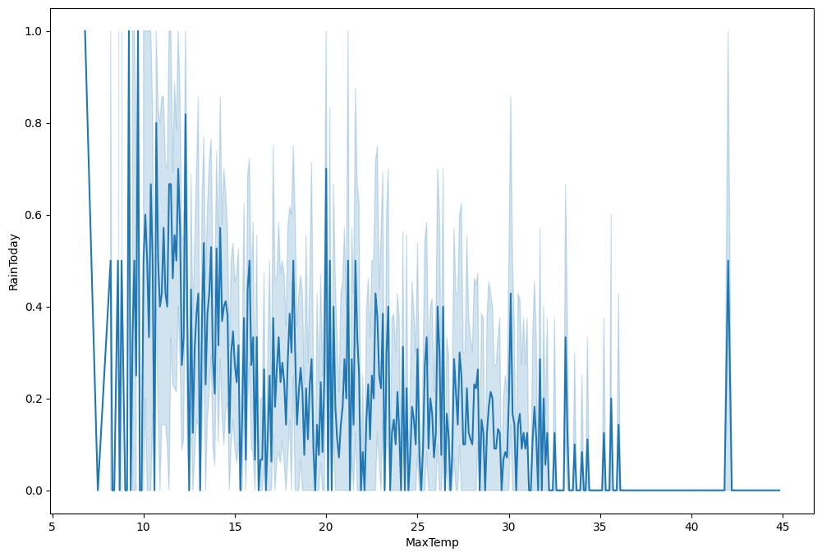
How temperature affects chances of rainfall?

Slide 14
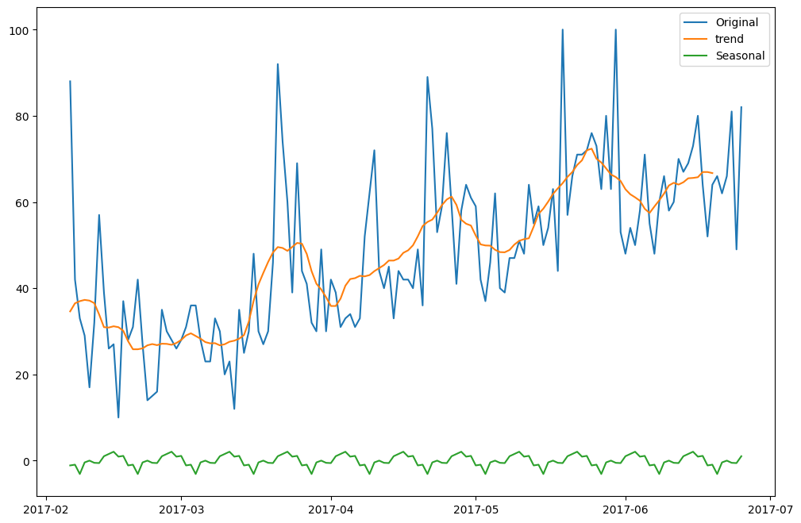
Is there any trend & seasonality in the dataset?

Slide 15
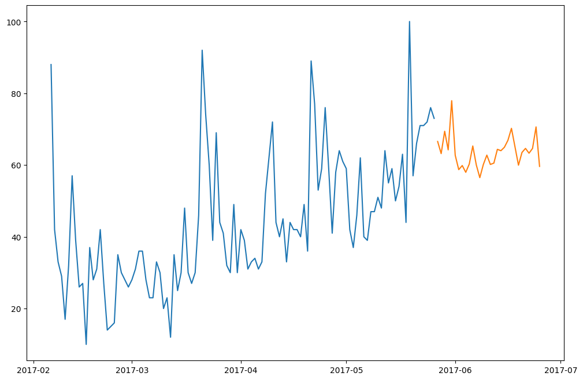
What are the model predicted values?

Slide 16
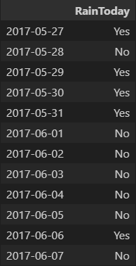
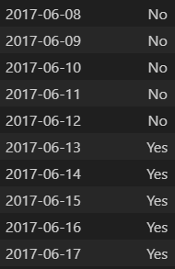
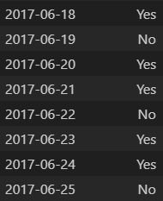
Will it rain for the next one month?

Slide 17
Couclusion
Humidity is the main factor affecting the rainfall.
Average value for humidity = 63.343598
There are high chances of rainfall when the value of humidity is greater than 63.343598.
There are low chances of rainfall when the value of humidity is lesser than 63.343598.
When temperature is between approximately 10 degrees to 25 degrees then there are high chances for rainfall if humidity conditions favours.

Slide 18
Thankyou!

